Slide 1
Wave Data Analysis
OCE2901 – Surf Engineering Analysis

Slide 2


Preamble
Group 1: How did your first deployment go?

Slide 3

Group 2: Are you ready for your first deployment?
Is this information correct?
Date: Wednesday March 1
Time: 10:00
Place: Paradise Beach

Slide 4
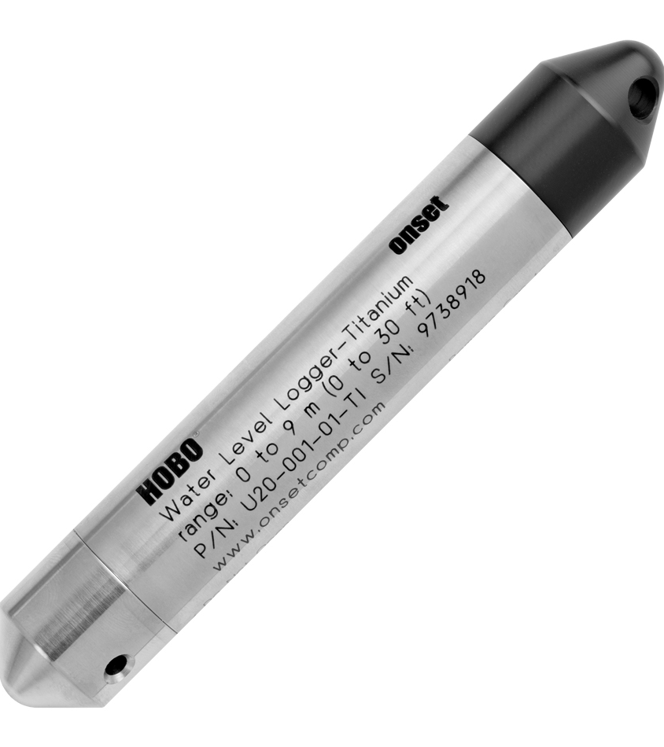
Refresher: What do our sensors record?
The HOBO U20 water level logger records the water pressure (and temperature) around it
Max Depth: <10-meters
Typical error: ±0.05% FS, 0.5 cm water
Max error: ±0.1% FS, 1.0 cm water
Resolution: 0.21 cm water

Slide 5
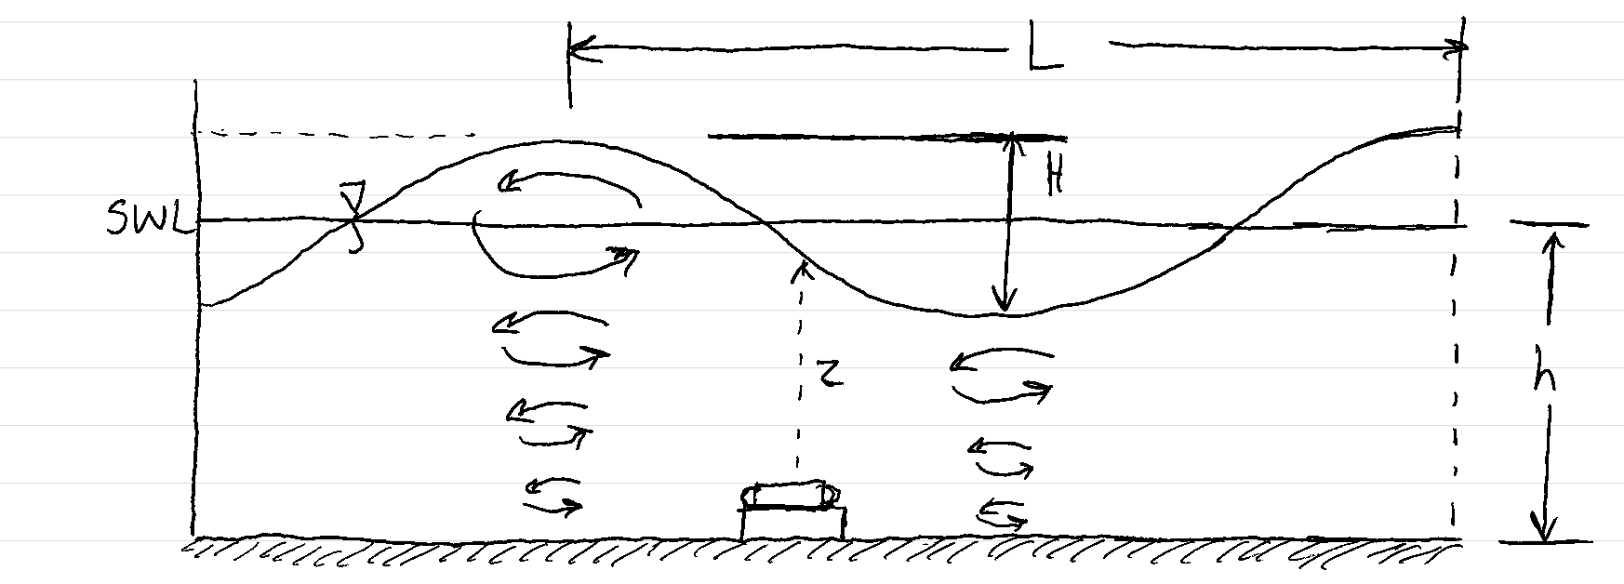
Refresher: Pressure Beneath a Wave
What two types of pressure are present at the bottom?

Slide 6
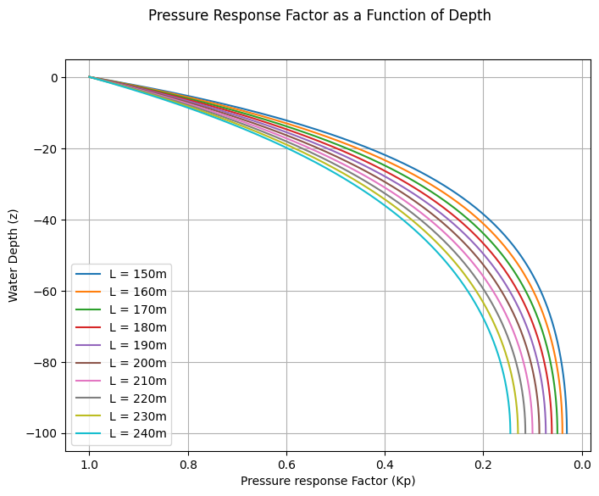












Refresher: Hydromechanical Pressure
$$P_{s}=−ρgz=ρgh, z=−h$$
$$P_{d}=ρgηK_{p}$$
$$P_{T}=ρg(h+ηK_{p})$$
$$K_{p}=\frac{\cosh\left(k\left(h+z\right)\right)}{\cosh\left(kh\right)} ≡Pressure Response Factor$$
$$k=\frac{2π}{L}≡Wave Number$$
0
Zeroth-order: $\frac{P_{T}}{ρg}−h=η$
$$at the surface, h=0$$
$$η\left(t\right)=\frac{P_{T}\left(t\right)}{ρg}$$
0
First-order: $\frac{P_{T}}{ρgK_{p}}−h=η$
$$at the surface, h=0$$
$$η\left(t\right)=\frac{P_{T}\left(t\right)}{ρgK_{p}}$$
1
Why can we assume $K_{p}=1$?

Slide 7
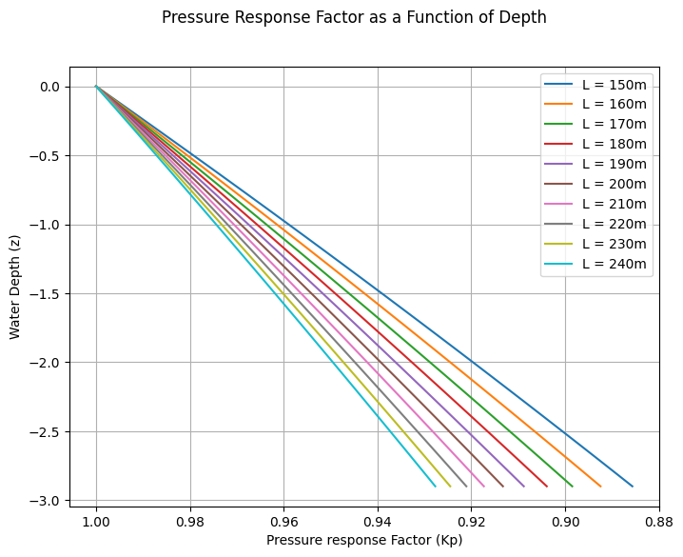

For more accuracy, we can average $K_{p}$ across multiple wavelengths at our mean depth and apply that to our pressure conversion

Slide 8
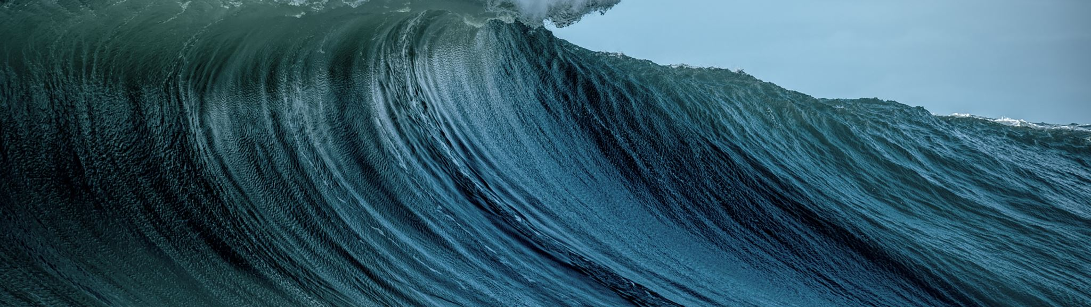
Wave Parameters Pt. 1
Wave-By-Wave Analysis

Slide 10

Questions?

